Slide 1
Getting Started with Dreamweaver
Art 3001

Slide 2
LinkedIn Learning Tutorials:
https://www.linkedin.com/learning (Formerly called Lynda.com)
With a library card in the state of Ohio you can access LinkedIn Learning tutorials for free.
You do not need a LinkedIn profile.
LinkedIn Learning offers tutorials on a wide range of digital software related to this course and can be a valuable source of detailed information on techniques and tools. You can apply online for a Columbus Metropolitan Library Card: https://www.columbuslibrary.org/card-application
Columbus Library Login:
https://www.linkedin.com/learning-login/go/oh0057

Slide 3
LinkedIn Courses:
HTML Essentials: https://www.linkedin.com/learning/html-essential-training-4
Dreamweaver Essentials: https://www.linkedin.com/learning/dreamweaver-cc-essential-training-2
CSS Courses: The first course is more in-depth, and longer, the second is shorter
CSS Essential Training: https://www.linkedin.com/learning/css-essential-training-3
Introduction to CSS: https://www.linkedin.com/learning/introduction-to-css

Slide 4
HTML basics in Dreamweaver
Watch tutorials on HTML & Dreamweaver Essentials

Slide 5
Important HTML Basics & Dreamweaver
HTML consists of elements, each of which may be modified by some number of attributes. HTML documents are connected to each other with links.
Content in HTML is identified by wrapping it in an HTML tag.
Structured like a sandwich!
Dreamweaver lets you work between writing HTML code and designing visually.

Slide 6

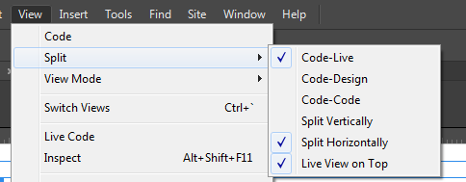
Dreamweaver Interface
Edit HTML both visually and with code
Split View – Code & Live/Design views
Look for CODE / SPLIT / LIVE across the top
Menu bar > View > (top 3 options)
Live and Design show the visual edits
Each has different advantages

Slide 7
Panels
Files Panel – shows the files in your site
Insert Panel – shows actions for adding content
Properties Panel: Window > Properties: Dock this panel at the bottom of the window – it will be useful.
DOM – Document Object Model: Used for viewing structure of page
CSS Designer – useful for adding css style to your pages
Do things look weird? Missing something?
Window > Workspace Layout > Reset Standard

Slide 8
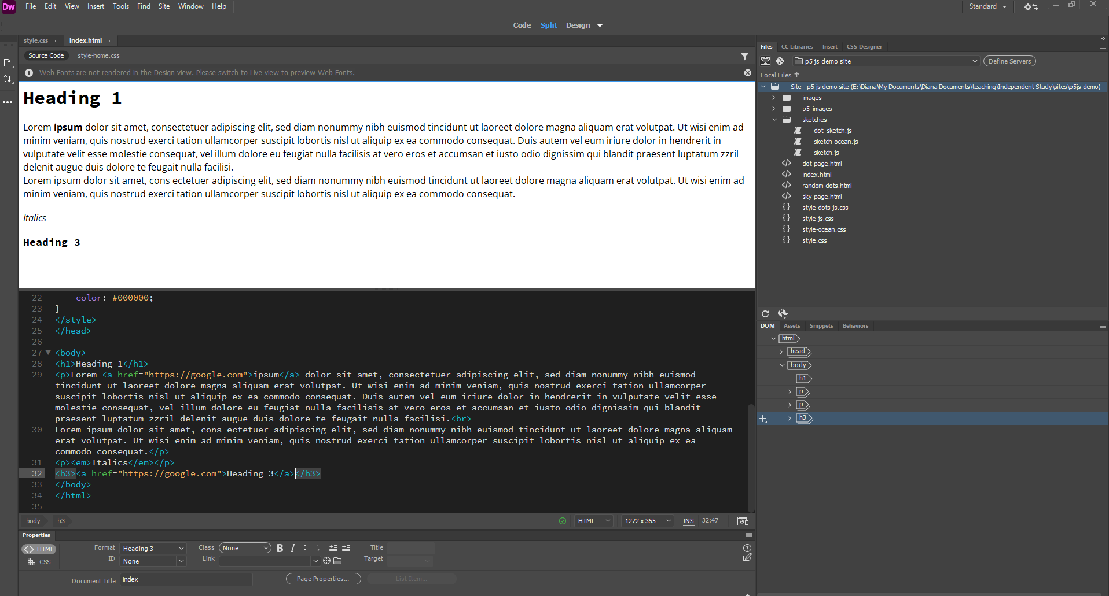

Slide 9
Setting up a Site
Site Root Folder
This is a local spot on your computer that will contain all your web pages and assets
Name things without spaces, all lowercase
Choose clear, simple filenames
Site > New Site…
Choose a descriptive name (only part of DW)
Choose the location of the Site Root Folder
Site > Manage Sites
In the File Panel you can use the drop down to switch between working on different sites
It will show a list of the files and folders within each site’s root folder.

Slide 10
Create New HTML pages
File > New > HTML document
Save this file immediately
First html webpage should be called index.html
When uploading to a server, it understands this as the first page to display out of a group of files.
Subsequent pages can be named anything
Avoid spaces, uppercase. Use informative and simple filenames.
Your new files will appear in the File Panel

Slide 11
Add Content
Type in Live view or Design View
Insert Panel – images, tables, etc.
When working with images, add your images to the site root folder FIRST!!! Then insert or link to those images.
Use the Properties Panel to add Links
You can use Properties and Page Properties to add basic formating pages. – choose Appearance (CSS)

Slide 12
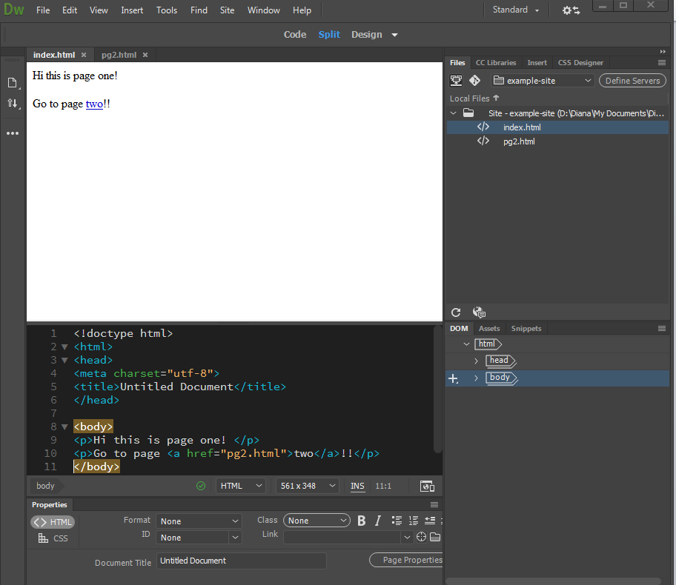
Preview in Browser

Slide 13
Links
The a tag is used when linking pages: <a> </a>
Example:
<p>Hi, this is a <a href=“linked_page.html">link</a> </p>
The tag is a for anchor, and the address is stored in the HREF attribute. The content between the opening and closing A tags becomes the clickable link. As well as text, you can put an image between the A tags and use that as a link.
When linking to another site, the value of the HREF attribute must begin with HTTP, HTTPS, or whatever protocol the external file uses. This type of link is also known as an absolute link. If you were to leave out the HTTPS:// at the beginning of this URL, browsers would think you're creating an internal link.
<p>take me to <a href=“http://google.com">google</a> </p>

Slide 14
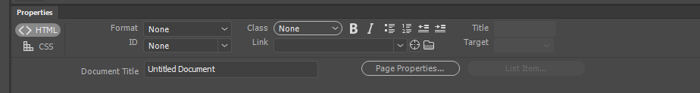
Images
Use Insert Panel, Insert Menu, or Assets Panel
Always be sure to add images from your site root folder!
Can add alt text
Can set size
Page Properties > can set background image

Slide 15
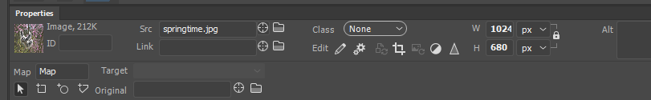
HotSpot Mapping
Select your image
Properties Panel: lower left corner: Map
Rectangle, circle, polygon
Draw on the image
Upper window: change from Live to Design
Select the hotspot to then define a link in the properties panel

Slide 16
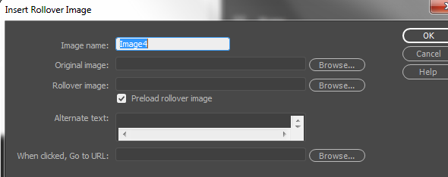
Rollover Images
Insert Panel > HTML > Rollover Image
Insert > HTML > Rollover Image
Define Image name with a simple and unique word
Set original image and rollover image
make sure everything is within root folder
Choose preload rollover image
Preview in Browser

Slide 17
Tips
Rollover images need to be the same size, or dreamweaver will scale the smaller image to be the same size as the big image.
If you want the effect of different sizes, use Photoshop and transparency (save .png) to create the illusion of different sizes.
You may need to switch from Live view to Design view to get some features to work.

Slide 18
Edit Rollover Settings / Add rollover to existing image
Select image – in Properties panel (bottom) fill in ID with a unique name.
Open Behaviors Panel (Window > Behaviors)
Click Plus Sign +
Choose Swap Image
Your named image will be selected already, or you can choose to affect a different image.
Browse to select rollover image
Can alter mouse on/mouse off settings
Click the minus sign to delete any behaviors

Slide 19
Adding CSS
Watch tutorials on CSS and Dreamweaver & CSS Designer

Slide 20
CSS
CSS stands for Cascading Style Sheets
HTML is used to structure a web document (headers, paragraphs, embedded images, video, and other media), CSS comes through and specifies your document’s style—page layouts, colors, and fonts are all determined with CSS.
Think of HTML as the foundation and CSS as the aesthetic choices

Slide 21
How it works
CSS brings style to your web pages by interacting with HTML elements.
Elements are the individual HTML components of a web page.
Example: a paragraph:
<p>This is my paragraph!</p>
If you wanted to make this paragraph appear pink and bold to people viewing your web page through a web browser, you’d use CSS code that looks like this:
p { color:pink; font-weight:bold; }

Slide 22
How/Where is CSS code applied?
Like HTML, CSS is written in simple, plain text written through any text editor on your computer
We will work in DW to generate the code
Three main ways to add that CSS code to your HTML pages:
external, internal, or inline.
Usually, external style sheets are the most efficient method for implementing CSS on a website (it’s easier to keep track of and implement a site’s style from a dedicated CSS file), while internal style sheets and inline style can be used on a case-by-case basis when individual style changes need to be made.

Slide 23
External
A file of its own, saved as .css
Can be used to determine the appearance of an entire website through one file (rather than adding individual instances of CSS code to every HTML element you want to adjust).
In order to use an external style sheet, your .html files need to include a header section that links to the external style sheet and looks something like this:
<head>
<link href="styles.css" rel="stylesheet" type="text/css">
</head>
All of the CSS instructions in that file will then apply to your linked .html pages

Slide 24
Internal
Internal style sheets are CSS instructions written directly into the header of a specific .html page. This code will only affect the file it is written within.
Useful if you have a single page on a site that has a unique look.
<head>
<style>
Body { background-color:thistle; }
P { font-size:20px; color:mediumblue; }
</style> </head>

Slide 25
Inline
Inline styles are snippets of CSS written directly into HTML code, and applicable only to a single coding instance.
<h1 style = "font-size:40px; color:violet;"> Check out this headline! </h1>
This code would cause one specific headline on a single .html page to appear in violet, 40 point font.

Slide 26
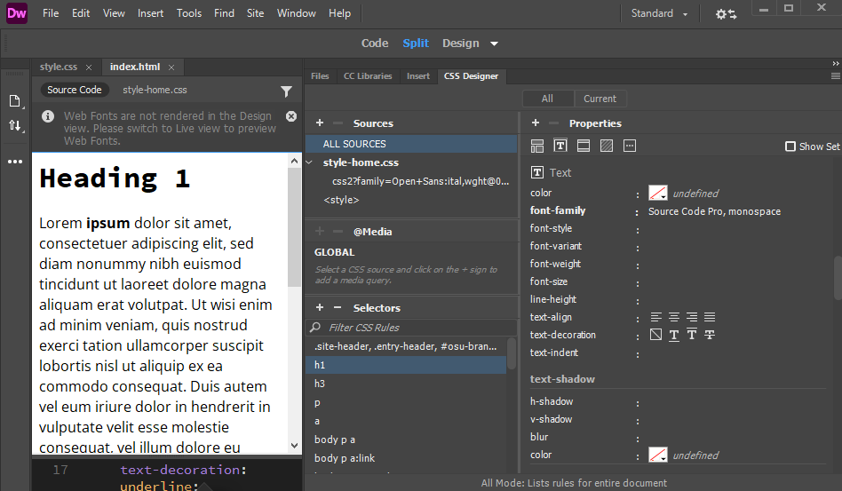
Using the CSS Designer Panel in DW
The CSS Designer Panel is on the right. Make sure you have enough space on screen to see both columns of the panel.

Slide 27
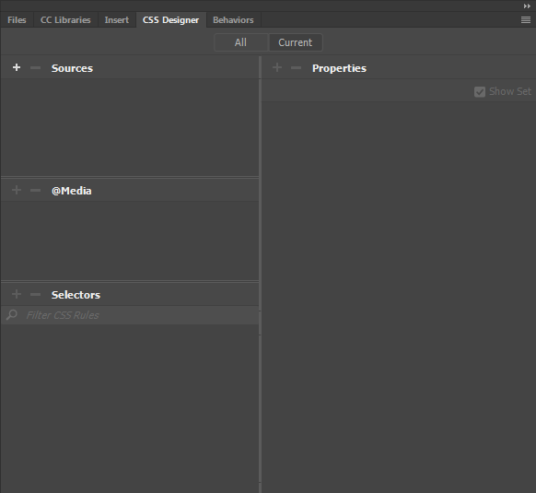
CSS Designer Interface
Current shows style for element currently selected
4 Major components in the panel:
Sources
@Media
Selectors
Properties
Begin with the + to add a new
CSS rule
Toggle “Show Set” to see what properties are already set, or all available properties
See your linked external
CSS file here
Make actual design choices here.
Note “Show Set”
This helps you see what you have styled.
For setting up media queries; ex for establishing format rules based on screen size
Choose what you
want to style in your
website.
Choose class / ID / elements

Slide 28
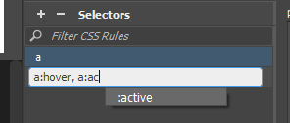
Locate Property & Set its Value
Try styling <p></p> (paragraphs)
And <a></a> (links) (see details here)
Make different parts in your HTML Page
Generic: <div> more formal: <section> <article>
Apply a Class (.) or an ID (#) to these parts
Class can be used multiple times, ID is unique.
Create a style in CSS that links to these named sections.

Slide 29
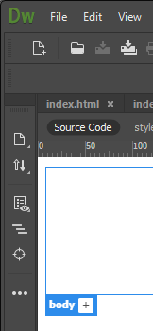
Layout
Box Model – Mozilla Developer Page
Box Model – W3 Schools Link
W3 Schools is another great resource. With the link above, note there are exercises you can try for practice.
The Display property is the most important CSS property for controlling layout.
Align & Center: image, general css align
Use the “Inspect Mode” in Dreamweaver to see layout info. Left toolbar →

